Slide 1

Tweet aggregator demo

Slide 2
overview
Filter and retweet suitable content
Periodically sift through retweets and collect data such as:
Most liked tweet
Most retweeted tweet
Display timeline and collected tweets on a website

Slide 3
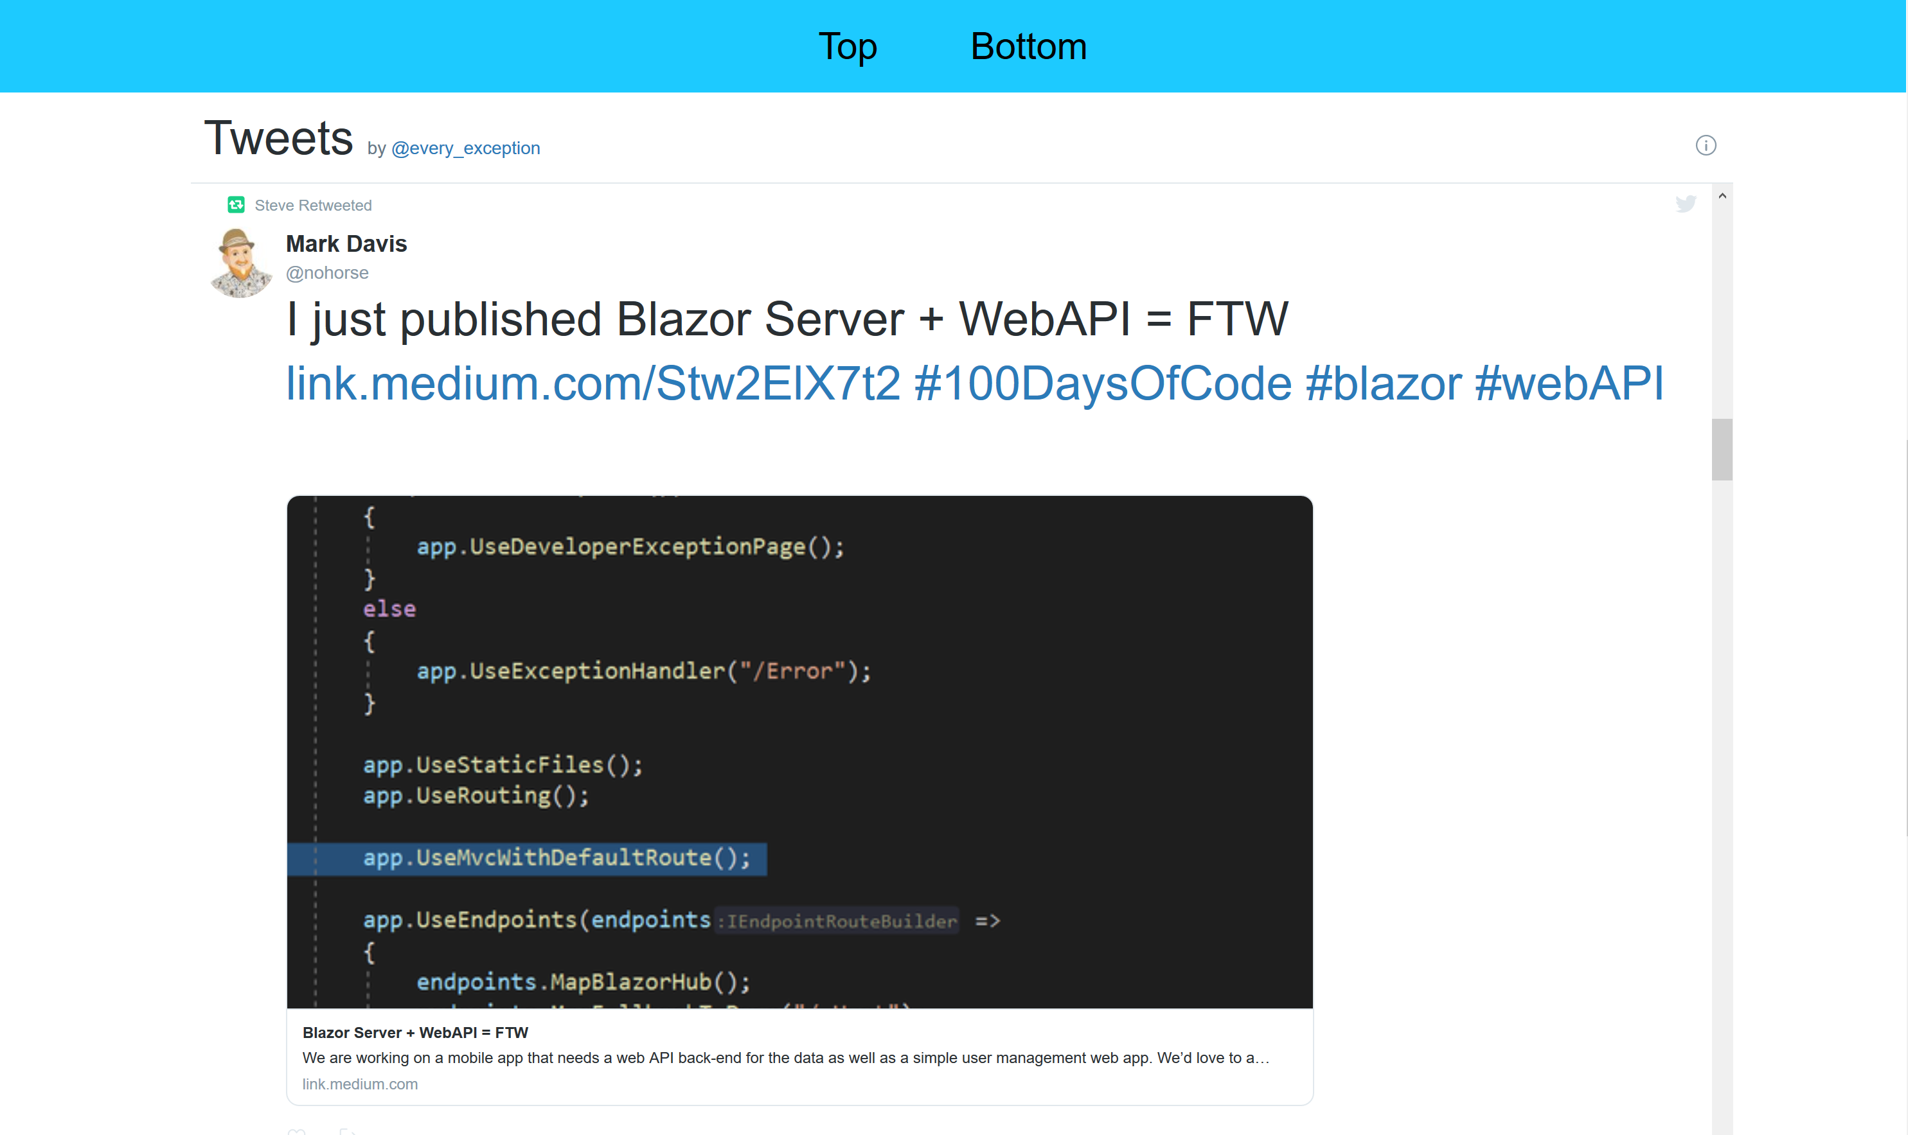

Slide 4
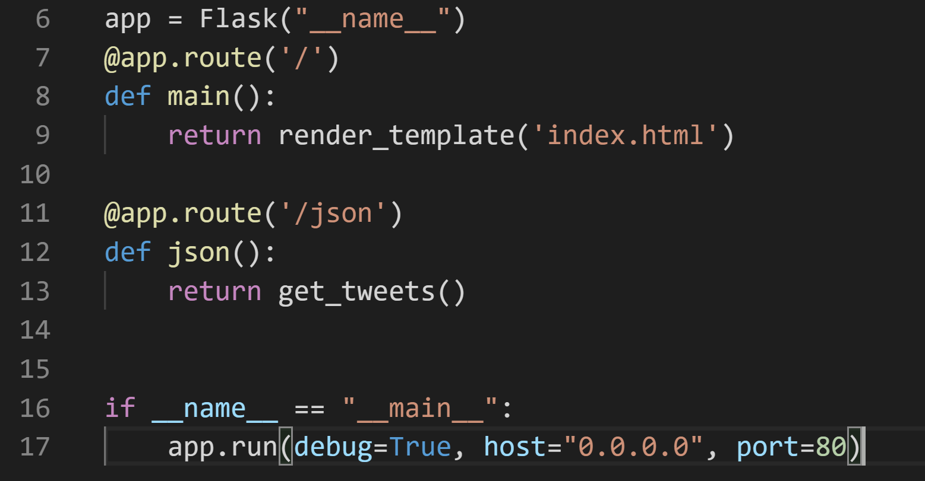
python server
app.py
Using Flask to host local server and serve files
Passing tweet data as JSON

Slide 5
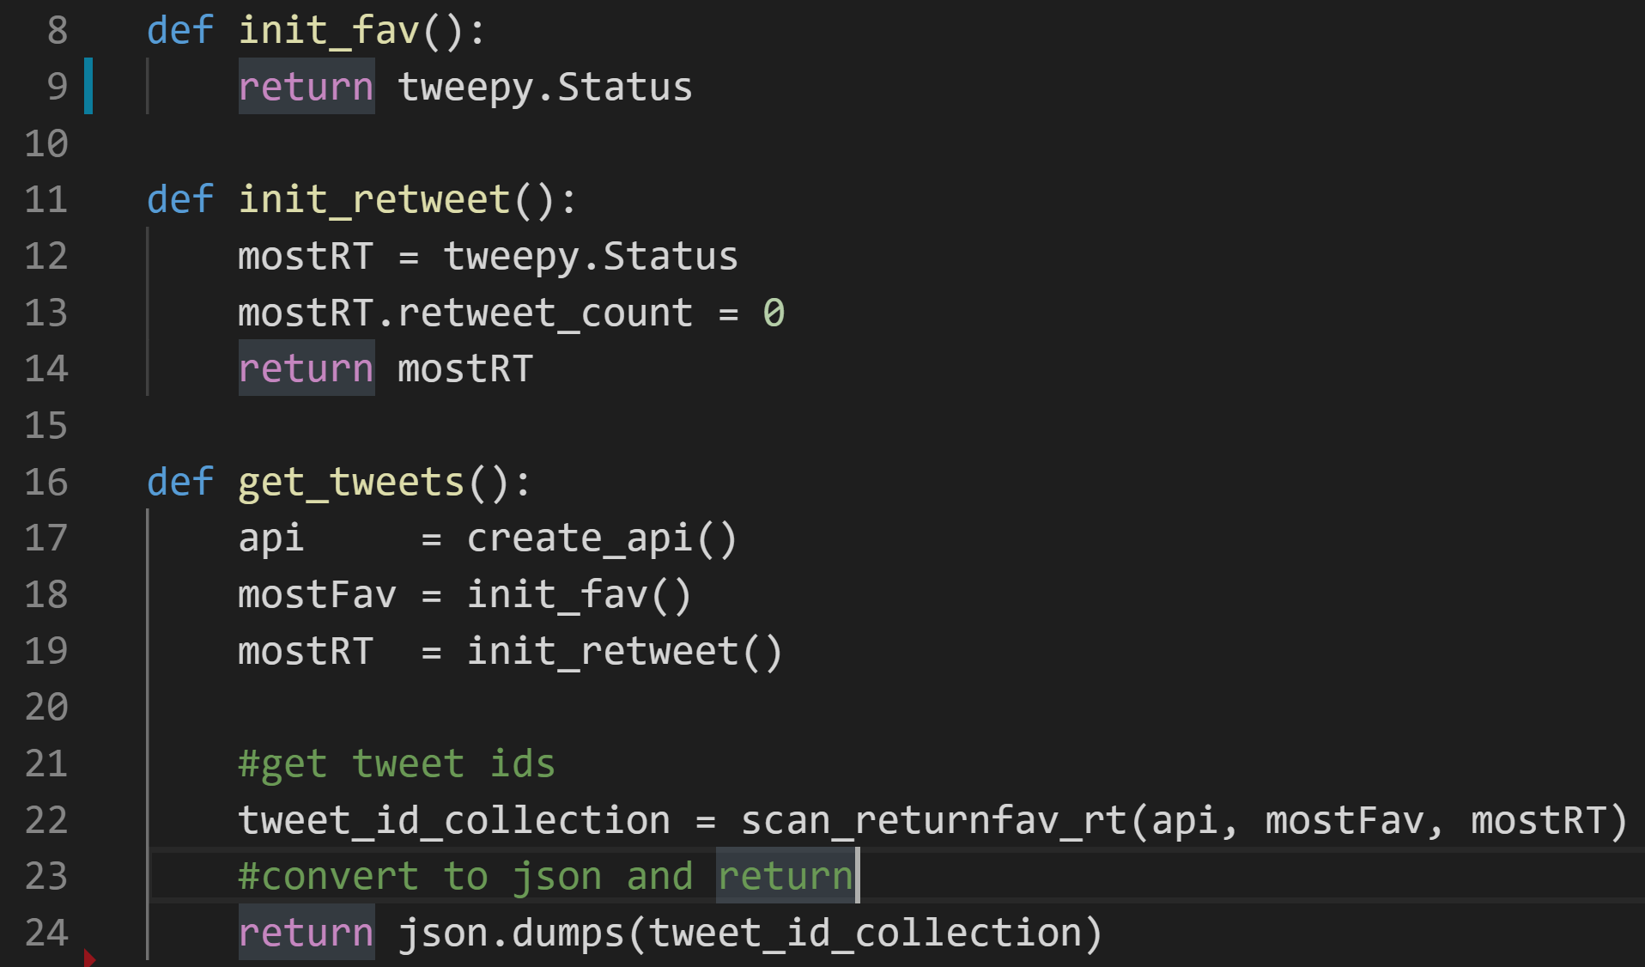
main file
wrapper.py
Authenticate twitter credentials
Initialize status objects
Return converted data (JSON)

Slide 6
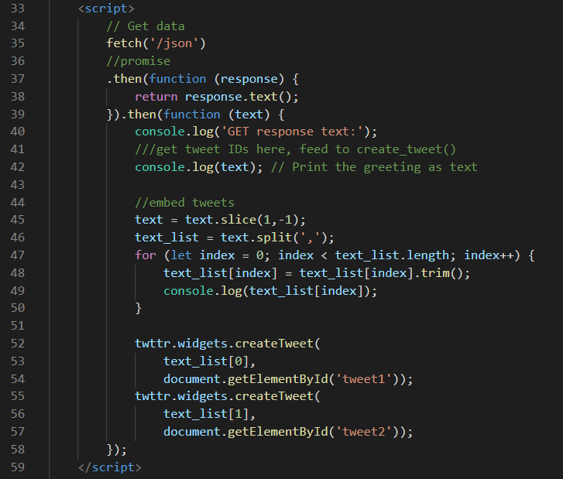
embedding tweets
Index.html
Retrieve data, as string
Trim white space and excess characters
Embed tweets

Slide 7
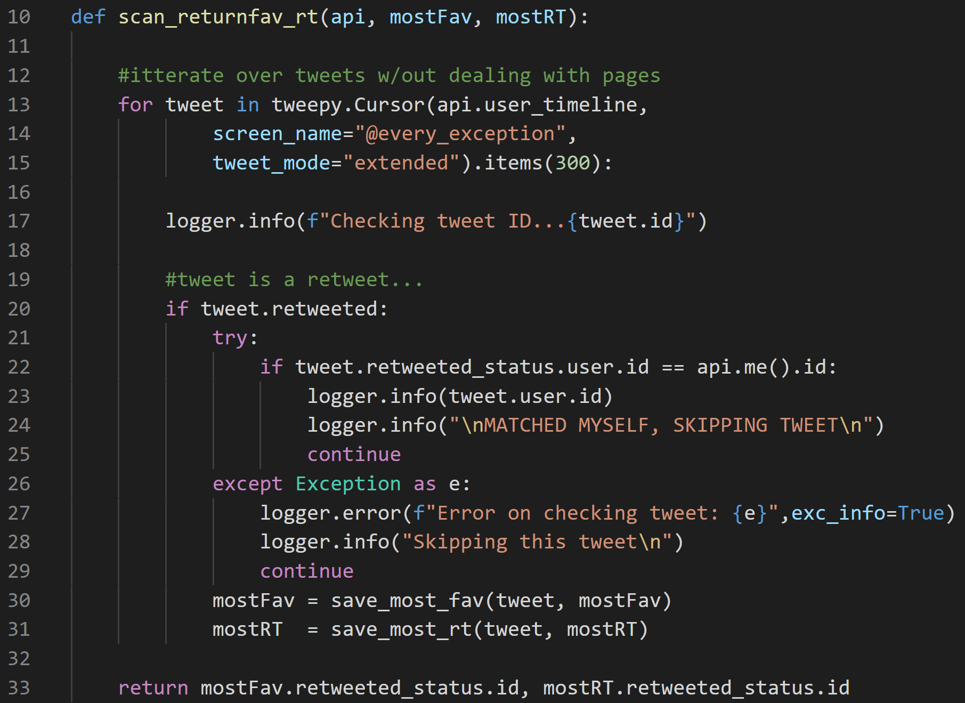
Iterate over tweets
scantimeline.py
“Cursor” skips twitter’s pages for speed
Cursor gets confused and attempts to re-process tweets sometimes

Slide 8
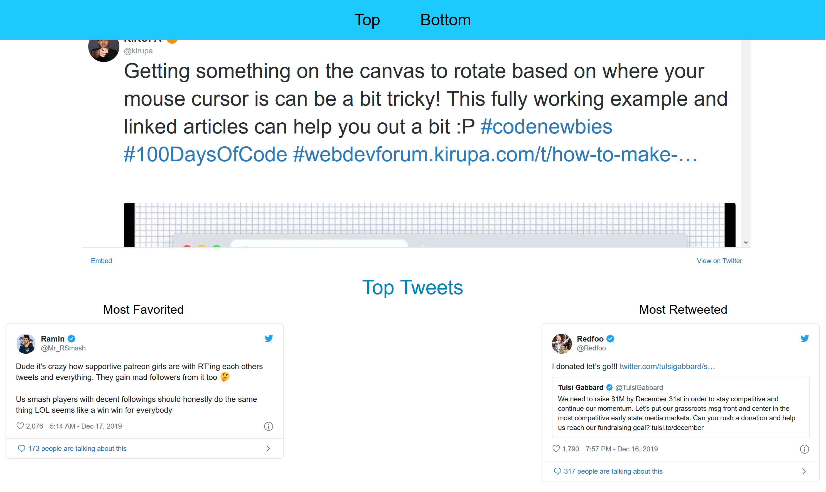

Slide 9
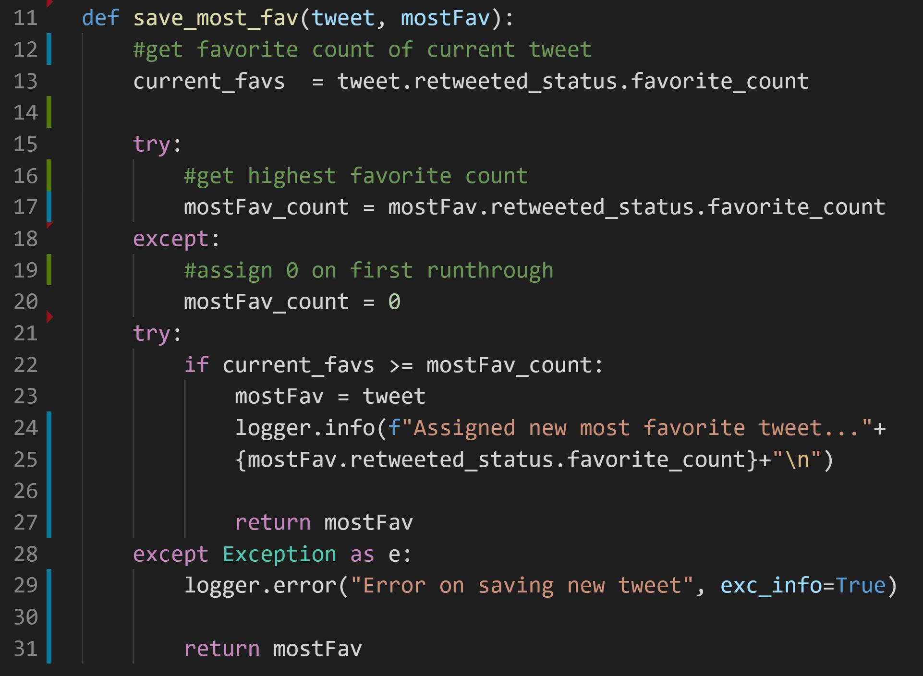
Compare for favorites
Compares favorite count of the current and the highest favorited tweet

Slide 10
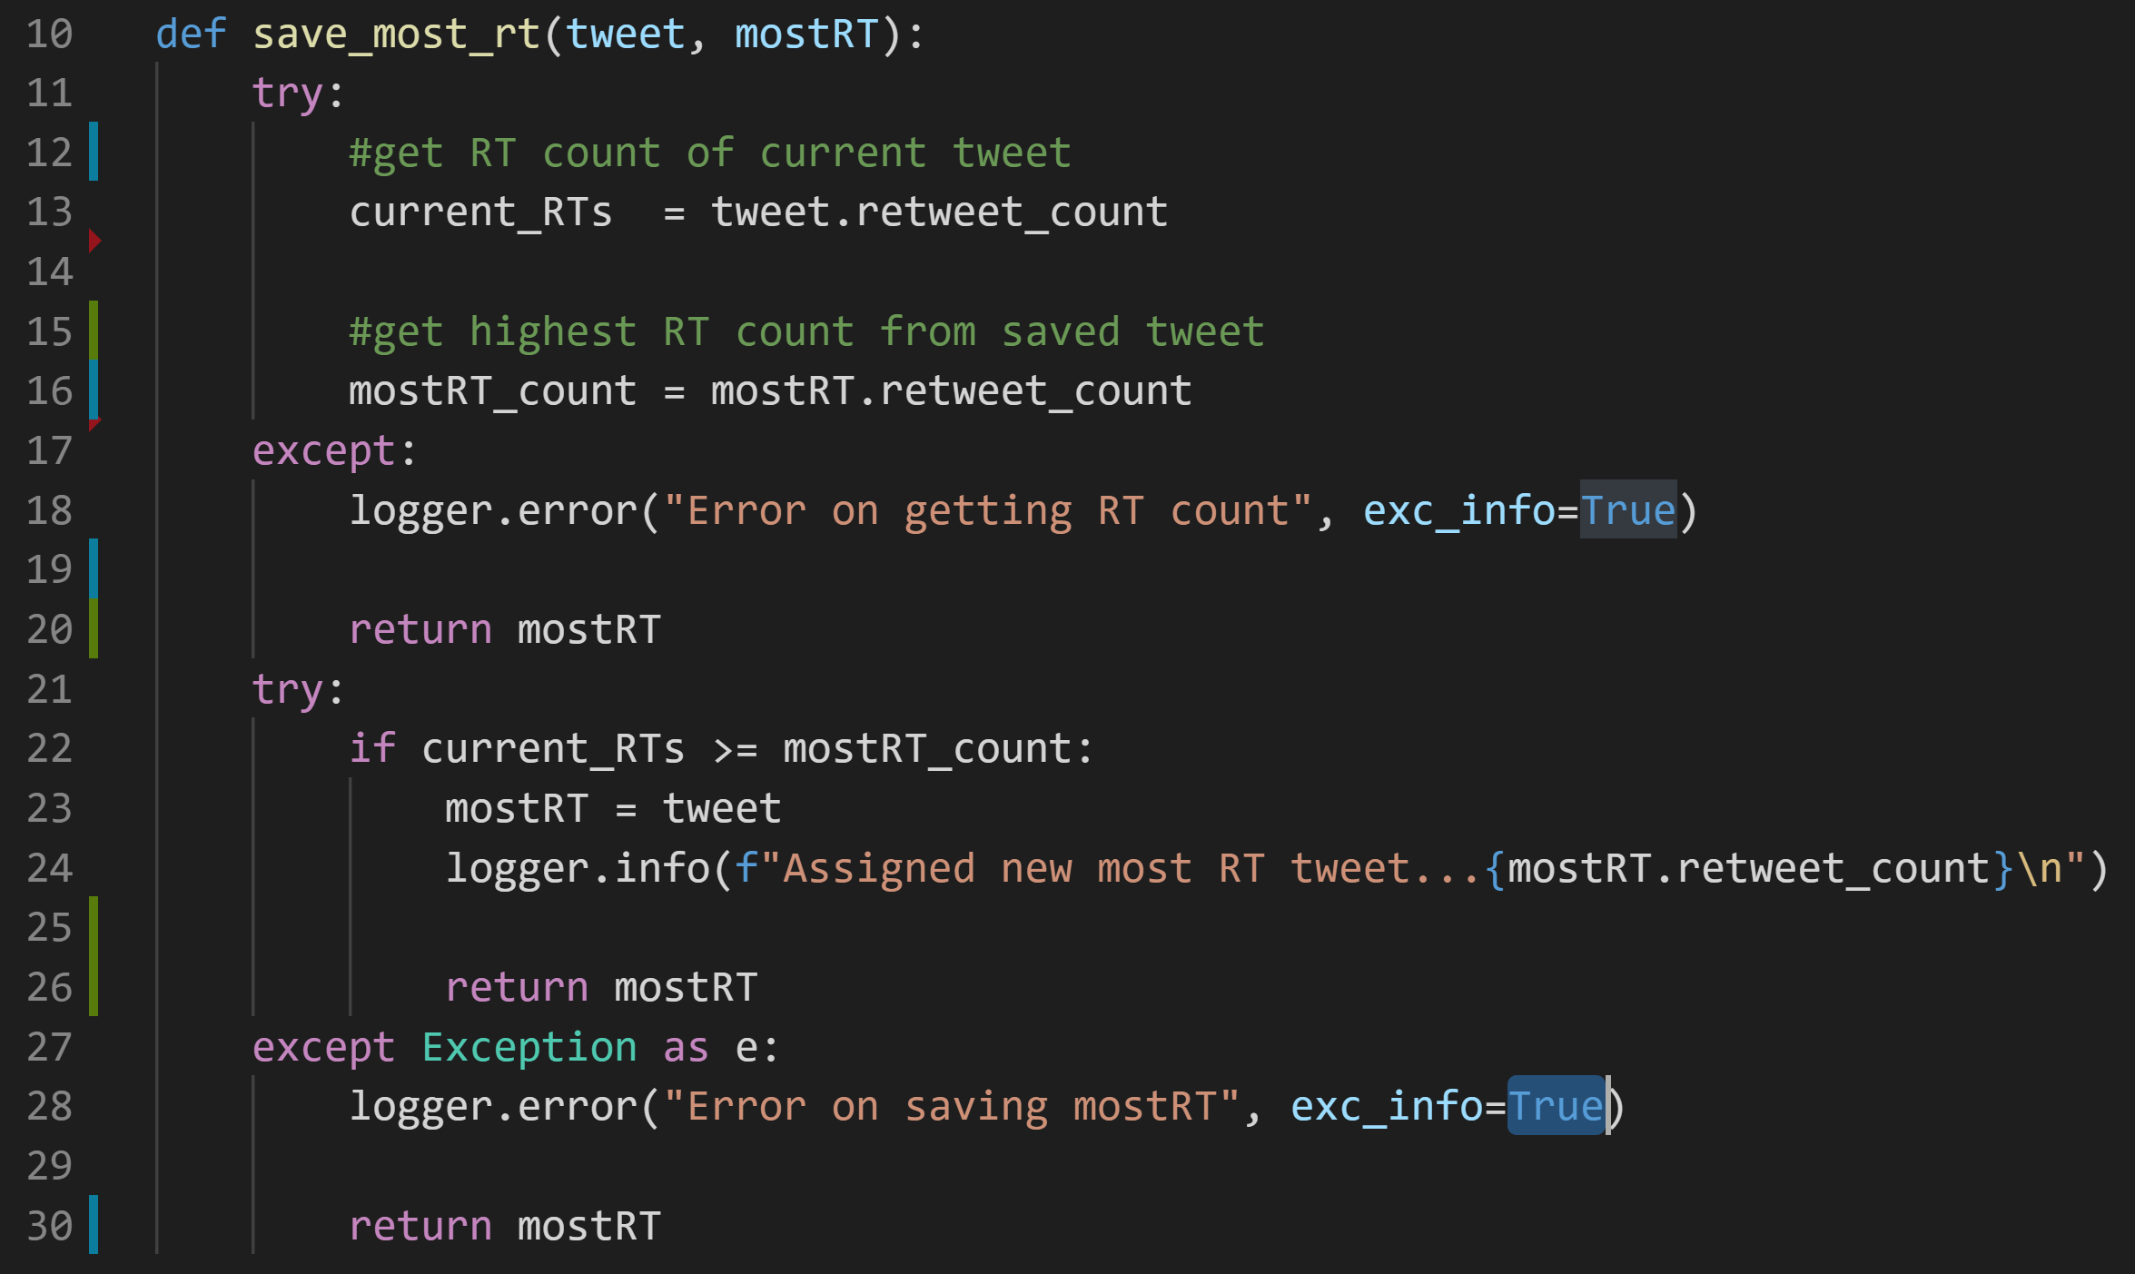
Compare for retweets
Compares retweet counts of current and most retweeted tweets

Slide 11
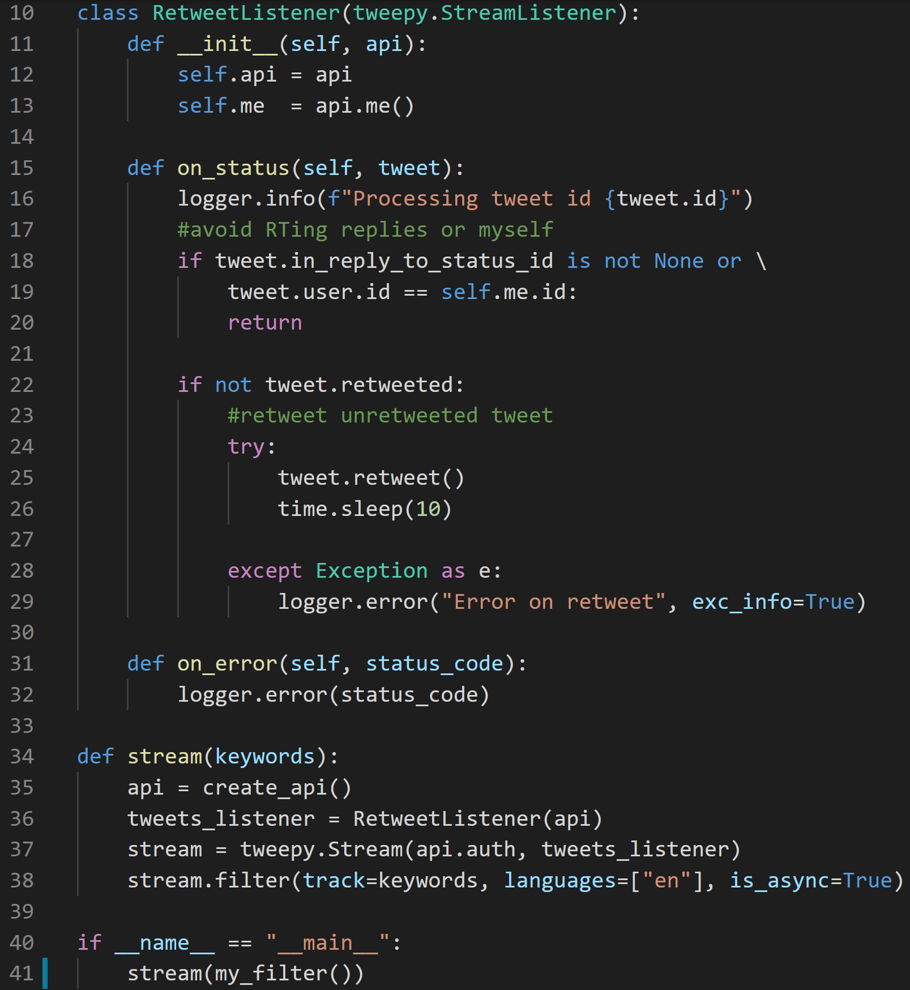
Retweet bot
retweetbot.py
Bot runs independently on same server
Streaming class to handle tweets
Filters via keywords, hashtags and/or phrases

Slide 12
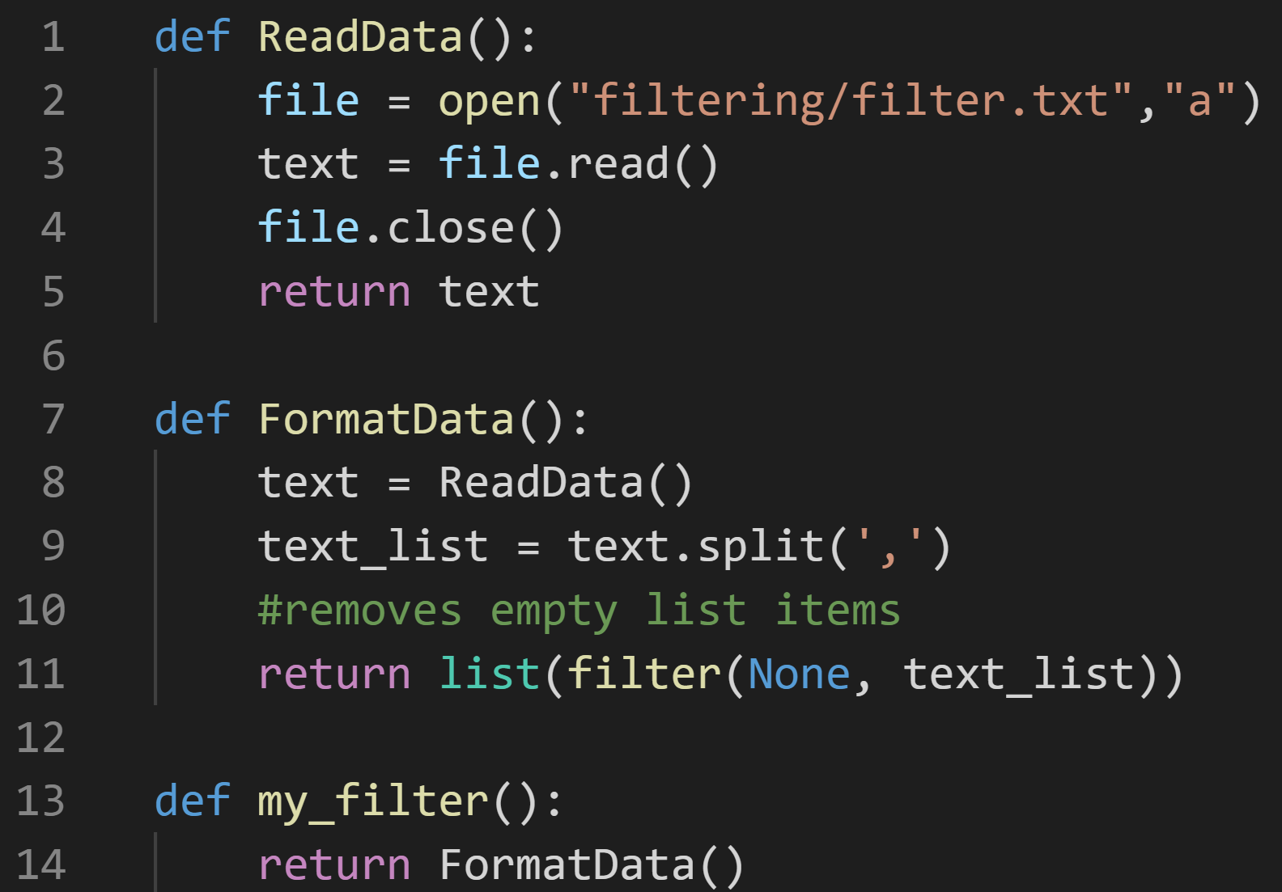
Filter app
my_filter.py
Formats a text file to an array of strings

Slide 13
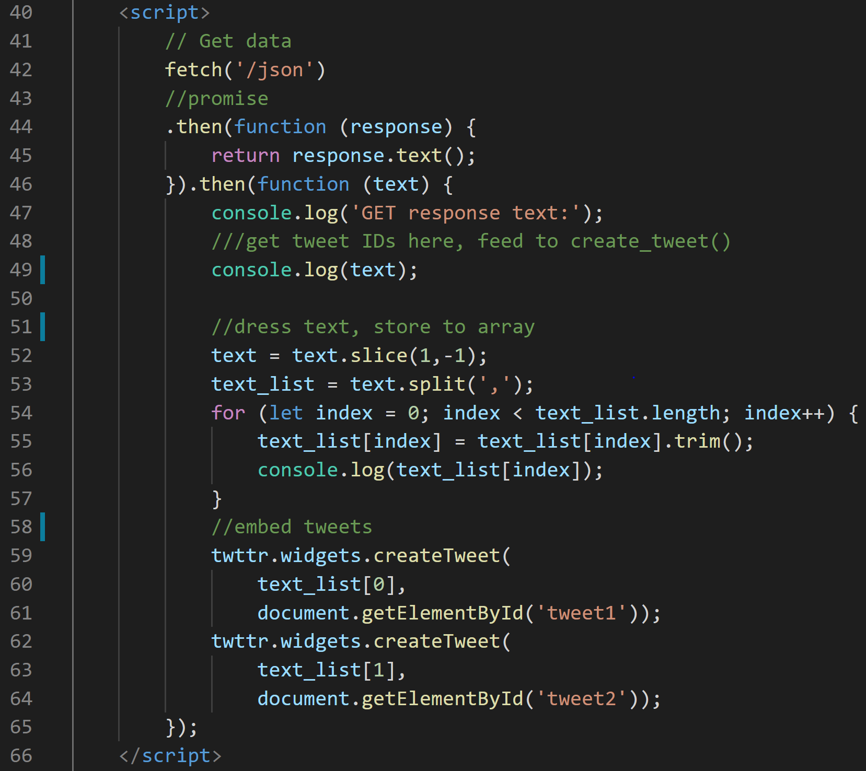
Get data from python
index.html
Asks/retrieves python for data
Fixes up text for twitter widget
Embed tweets

Slide 14
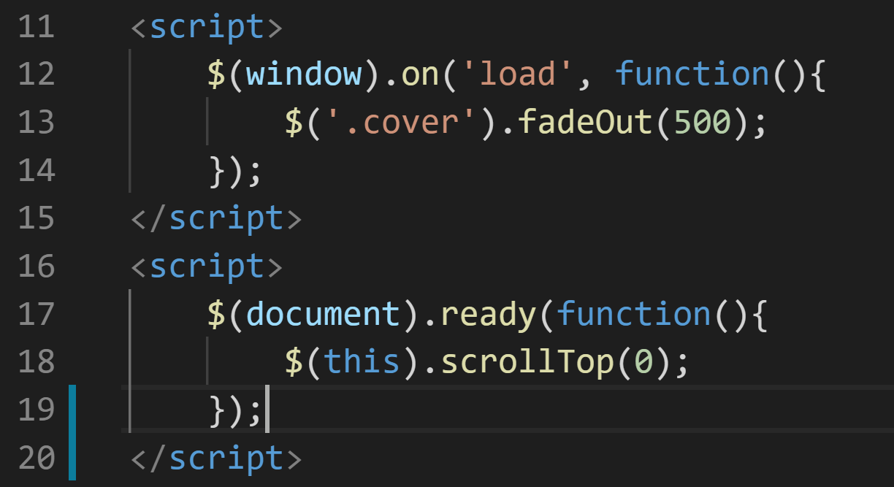
jquery
index.html
Fade out the screen cover on load
Force browser to load at the top of page

Slide 15

questions

